Slide 1
Techno etiquette
The First Step in Effective Communication
Adapted from:
“Can I Fax You a Thank You Note?” by Audrey Glassman and presented by: The Engineering Programs Office

Slide 2
Techno etiquette
The First Step in Effective Communication
ALWAYS KEEP IN MIND…
Courtesy
Sensitivity
Efficiency

Slide 3
Values
Integrity
Safety
Environment
Performance
People

Slide 4
COMMUNICATION TECHNOLOGY
Phone
Voice Mail
Email
Pagers/ Cell Phones
Internet
Fax
Copy Machines
Palm Pilot/ Laptops

Slide 5
PHONE
Answer phone in timely manner
Don’t chew gum, eat, side talk, work on your computer
Acknowledge person answering the phone
Take 1 minute to ask, “How are you?”
If you need to put them on “hold”, let them know & give a choice
Use of speakerphone

Slide 6
Voice mail
Avoid speakerphone
Speak slowly & clearly
Be succinct
Return calls

Slide 7
email
Look away when others input passwords
Always put subject
Minimize bandwidth, if possible
Scan all email before responding to eliminate redundancy
Chain letters/jokes

Slide 8
Internet
Screen savers
Surfing the web
WebPages/ Homepages

Slide 9
Pages/ Cell phones
Be sensitive to those around you
Never take to a meeting unless on silent mode
When in public, speak quietly

Slide 10
Rules of thumb
Know how to use your equipment
“Just because everyone does it doesn’t mean it’s right”
Minimize personal use when using the internet
Nothing is private

Slide 11
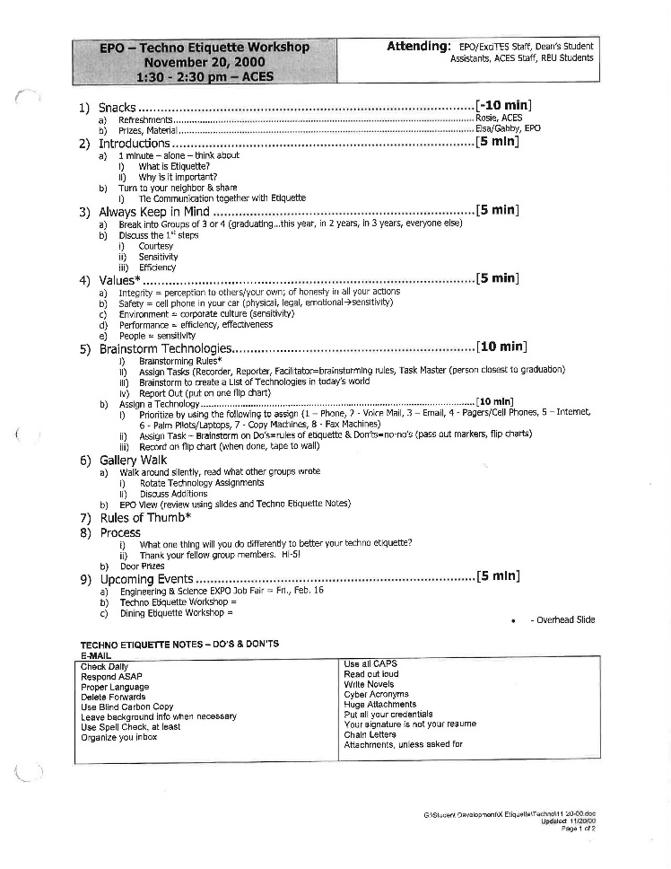
PAST AGENDAS

Slide 12
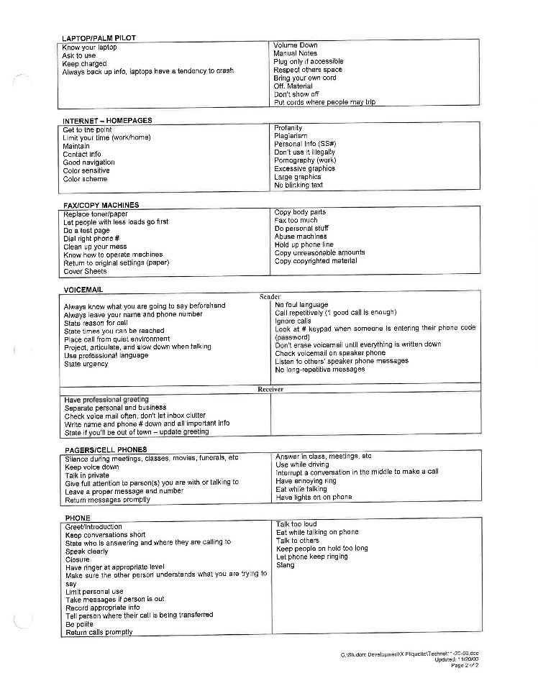
PAST AGENDAS CONT.

Slide 13
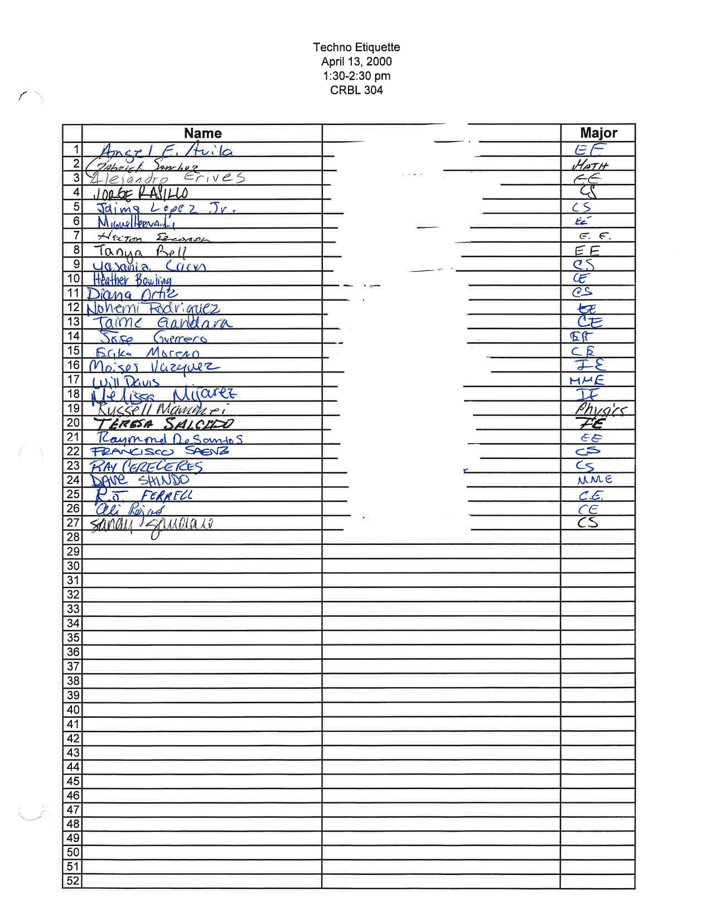
PAST ATENDEES

Slide 14
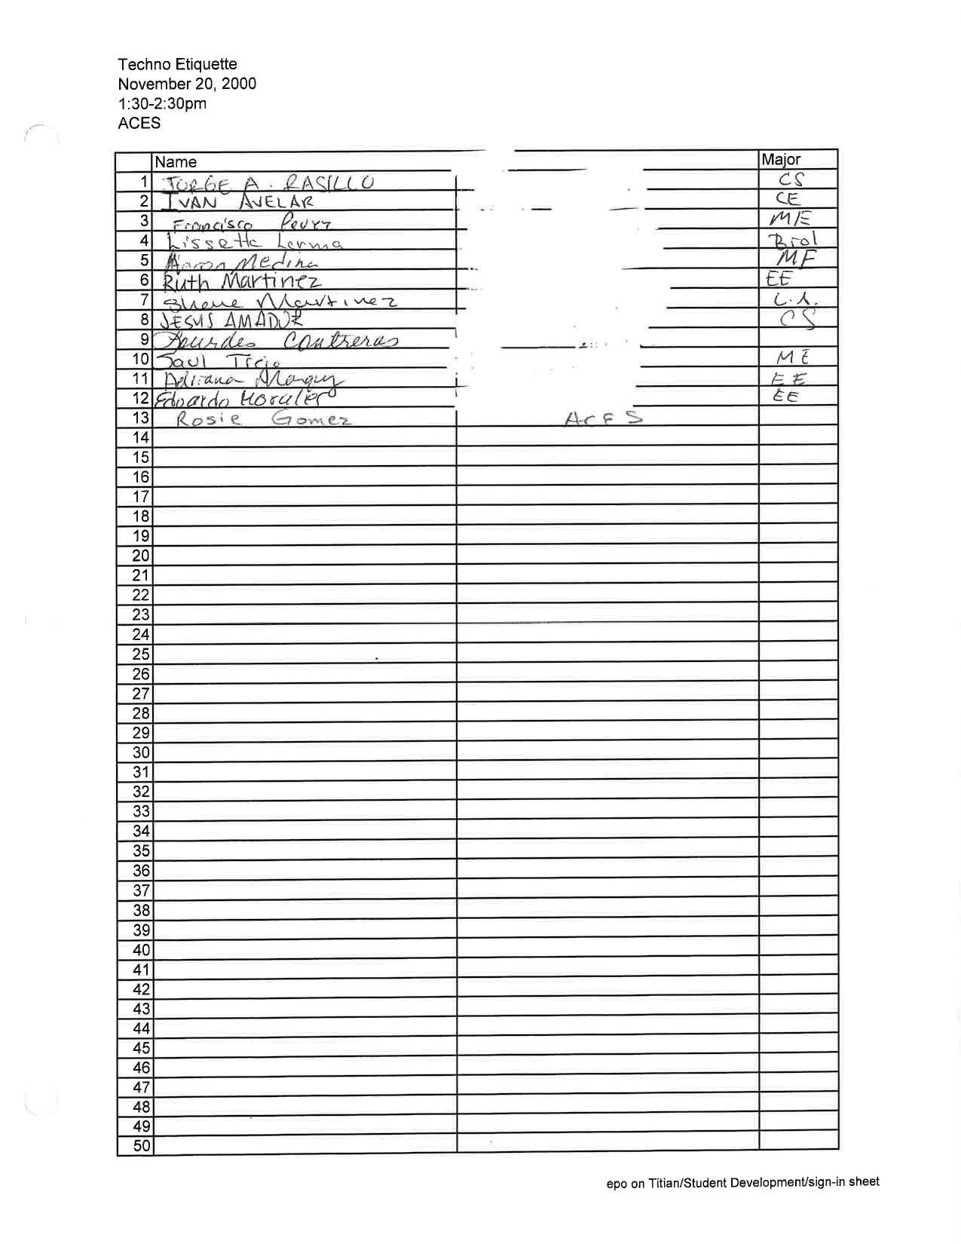
PAST ATENDEES CONT.

Slide 15
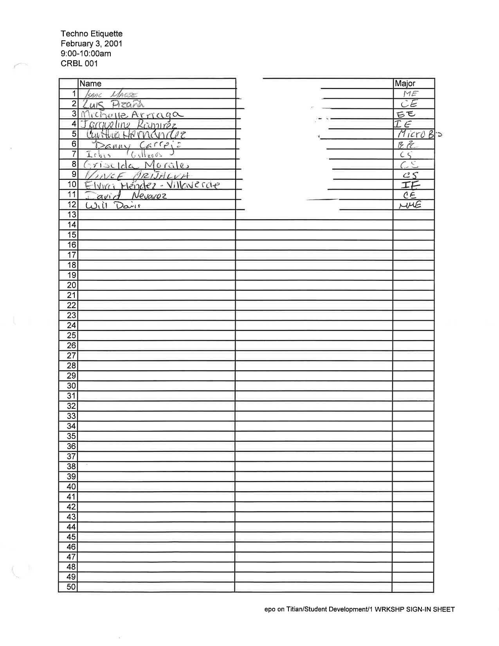
PAST ATENDEES CONT.

